Slide 1


EASTER
SPECIAL DAYS

Slide 2

The week before Easter is called the Holy Week. In the Christian church it is the week between Palm Sunday and Easter.
Translate following days of the Holy Week into Croatian.
Shrove Tuesday or Pancake Day
Ash Wednesday
Palm Sunday
Maundy Thursday
Good Friday
Easter Eve (Holy Saturday)
Easter Sunday
Easter Monday
Pokladni utorak
Pepelnica (Čista srijeda)
Cvjetnica
Veliki četvrtak
Veliki petak
Velika subota
Uskrs
Uskrsni
ponedjeljak

Slide 3
Read explanations of the traditions and customs on the days of the Holy Week.
On Shrove Tuesday or Pancake Day people in Croatia dress up and eat doughnuts or some other kind of cake. In Britain people eat pancakes and organise pancake races.
Ash Wednesday is the first day of a forty-day long period called Lent (Korizma.)
On Palm Sunday people take palm and olive branches to church.
On Maundy Thursday church services commemorate the Last Supper.
On Good Friday people fast and church bells stop chiming.
Easter Eve (Holy Saturday) is the day before Easter Sunday.
On Easter Sunday people celebrate Christ's resurrection. The Easter Bunny brings an Easter basket with chocolate eggs.
On Easter Monday people visit friends or spend the day in the country.

Slide 4

Divide into three teams. Each team must write answers on a sheet of paper and give it to the teacher to check. The fastest team wins.
https://wordwall.net/play/13524/114/807

Slide 5
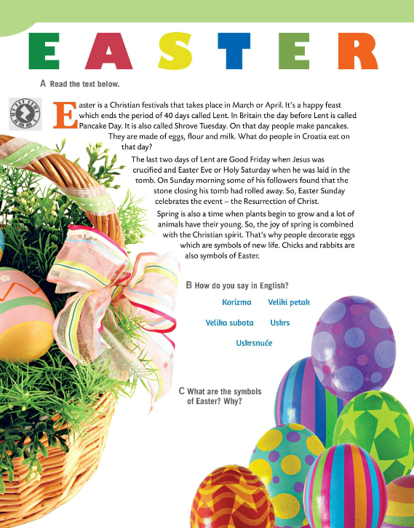
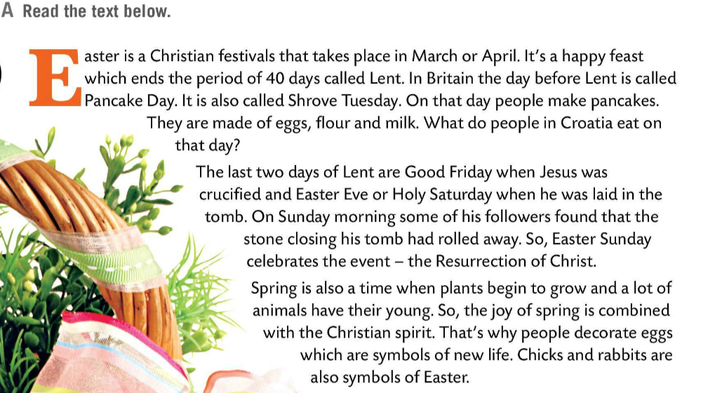
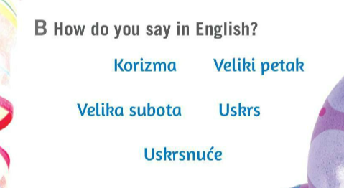
Read the text about Easter.
How do you say words from Task B in English?
Check.
Korizma – Lent
Veliki petak – Good Friday
Velika subota – Easter Eve (Holy Saturday)
Uskrs – Easter
Uskrsnuće – resurrection
What are the symbols of Easter? Why? Discuss in pairs. Share your opinion with the class.

Slide 6

Watch the video. Learn all about Easter in the United Kingdom and how it's celebrated.
Write five new words and translate them into Croatian.
Is British celebration of Easter similar to yours? Why?
What British tradition do you find most interesting?
Solve this crossword puzzle with the help of the given clues.
https://wordwall.net/hr/resource/1271949/easter

